Slide 1



^{An Introduction} ^{to Multivariate Regression}
^{Oscar Rondon}
^{October 2018}

Slide 2
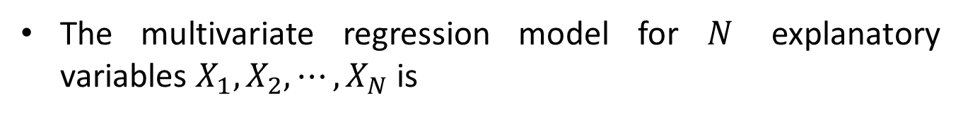

Multivariate regression is the natural extension of linear regression to include more than one explanatory variable
The linear regression model is
$$Y=aX+b+ ε$$
The multivariate regression model for $N$ explanatory variables $X_{1},X_{2}, ⋯,X_{N}$ is
$$Y=β_{1}X_{1}+β_{2}X_{2}+⋯+β_{N}X_{N}+β_{0}+ε$$

Slide 3
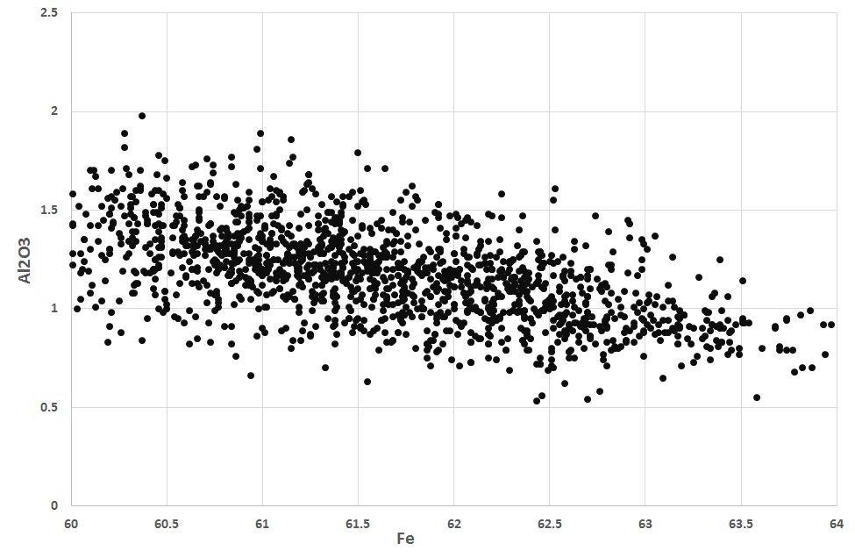
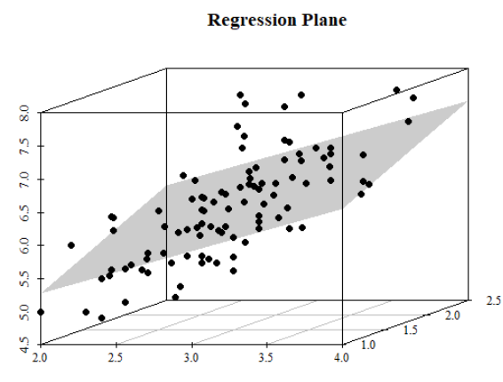
The linear regression model fits a line through the points
The multivariate regression model fits a plane through the points

Slide 4
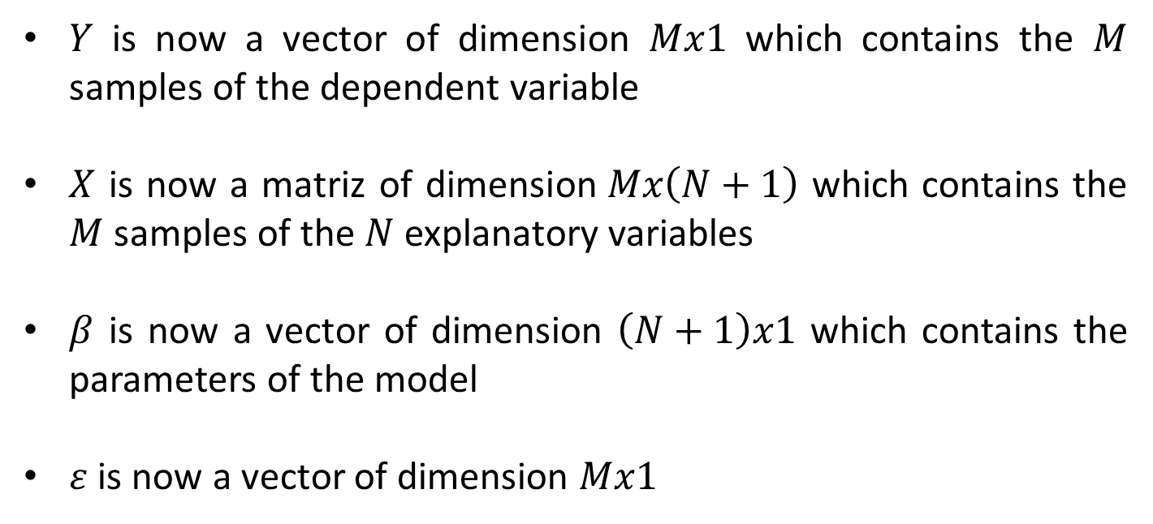
The multivariate regression model is usually expressed using matrix notation
$$Y=Xβ+ε$$
$Y$ is now a vector of dimension $Mx1$ which contains the $M$ samples of the dependent variable
$X$ is now a matriz of dimension$Mx\left(N+1\right)$ which contains the $M$samples of the $N$ explanatory variables
$β$ is now a vector of dimension $\left(N+1\right)x1$ which contains the parameters of the model
$ε$ is now a vector of dimension $Mx1$

Slide 5
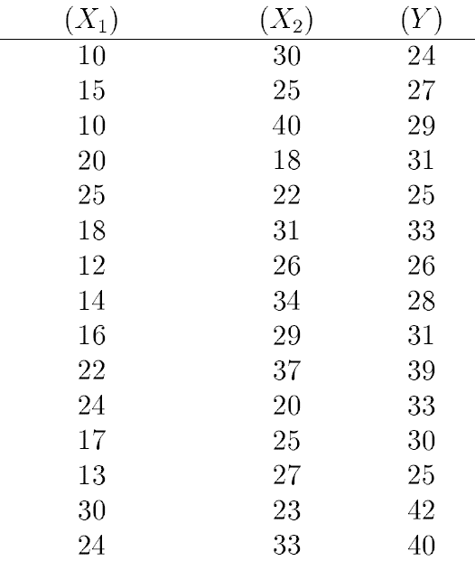
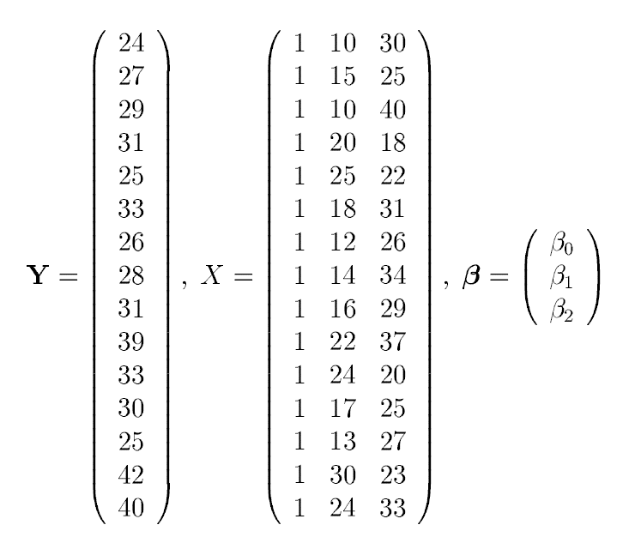
For instance, an Excel table with samples for two explanatory attributes and one dependent variable
15x1
15x(2+1)
(2+1)x1
Care should be exercised when entering the data into the program to run the multivariate regression model

Slide 6
Similar to the linear regression model, the assumptions are made on the error component
These assumptions are similar but in a multivariate setting
The error has multivariate Gaussian distribution with mean zero and constant variance
Homoscedasticity and no bias
The error is independent of all explanatory variables and the dependent variable
Scatterplot of the error with all explanatory variables should not show any clear pattern

Slide 7
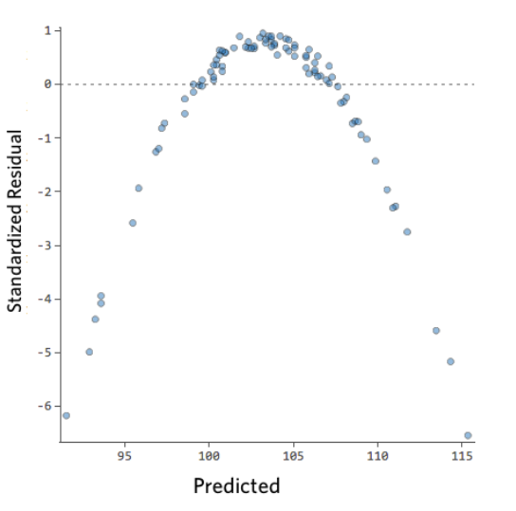
Some patterns are indicative that a transformation in one explanatory variable is needed
Worth considering a power transformation in the multivariate regression model, e.g.
$$Y=β_{1}X_{1}^{2}+β_{2}X_{2}+⋯+β_{N}X_{N}+β_{0}+ε$$

Slide 8
Validating a Multivariate Regression Model
^{Oscar Rondon}
^{October 2018}

Slide 9
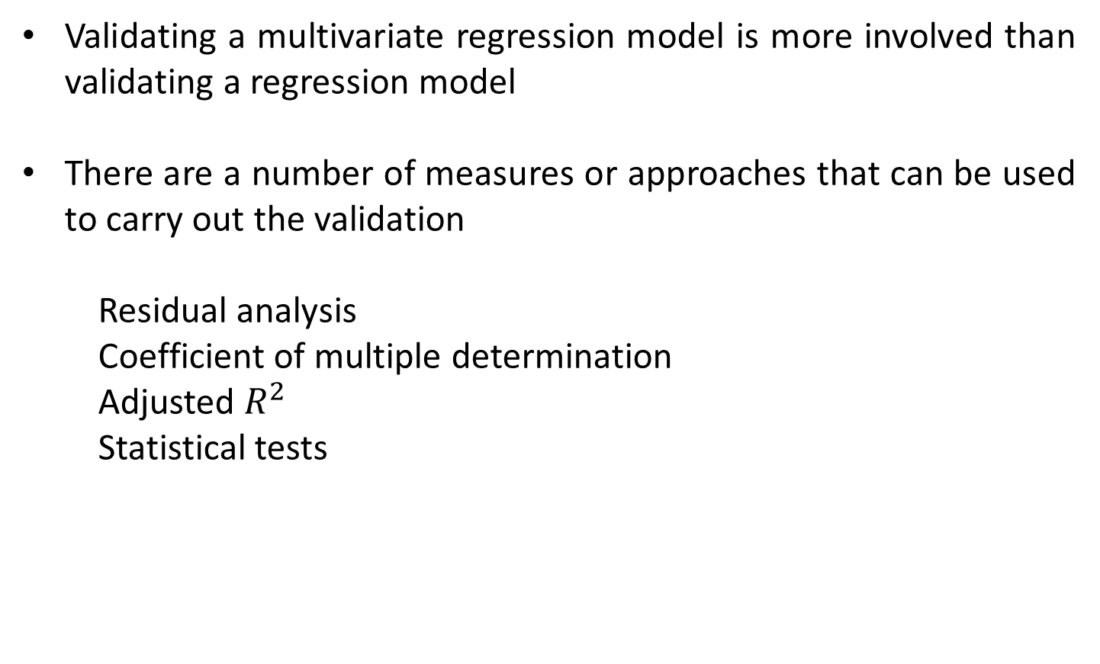
Validating a multivariate regression model is more involved than validating a regression model
There are a number of measures or approaches that can be used to carry out the validation
Residual analysis
Coefficient of multiple determination
Adjusted $R^{2}$
Statistical tests

Slide 10
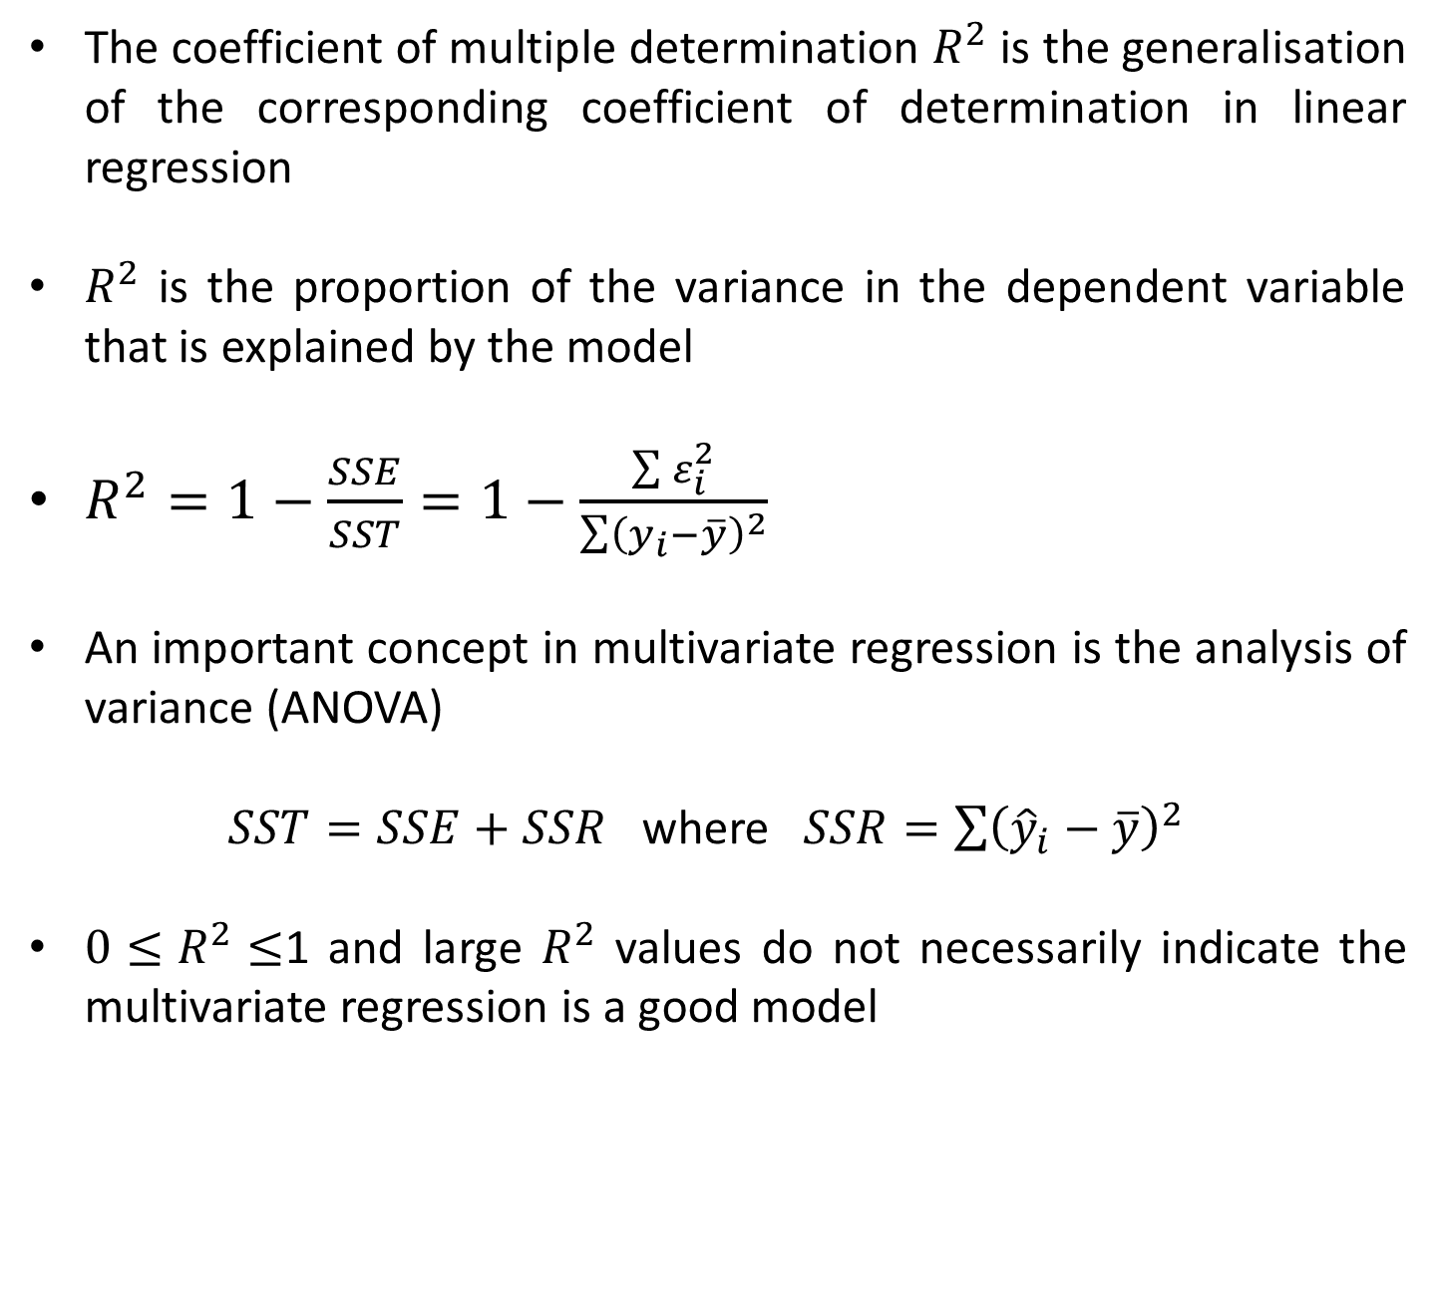
The coefficient of multiple determination $R^{2}$ is the generalisation of the corresponding coefficient of determination in linear regression
$R^{2}$ is the proportion of the variance in the dependent variable that is explained by the model
$R^{2}=1−\frac{SSE}{SST}=1−\frac{\sum{ε_{i}^{2}}}{\sum{{\left(y_{i}−\overline{y}\right)}^{2}}}$
An important concept in multivariate regression is the analysis of variance (ANOVA)
$SST=SSE+SSR$ where $SSR=\sum{{\left({\hat{y}}_{i}−\overline{y}\right)}^{2}}$
${0≤R}^{2}≤$1 and large $R^{2}$ values do not necessarily indicate the multivariate regression is a good model

Slide 11
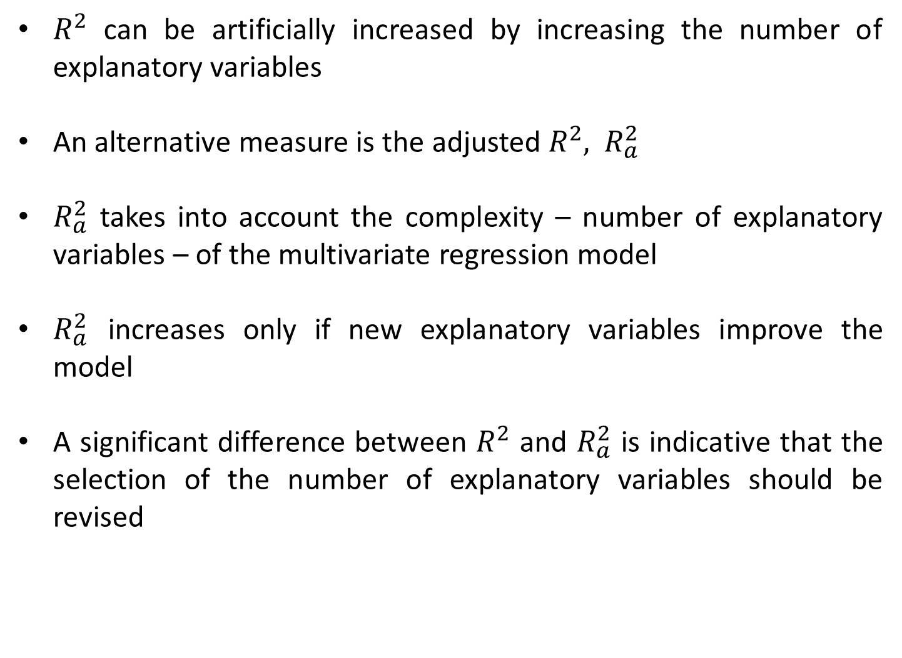
$R^{2}$ can be artificially increased by increasing the number of explanatory variables
An alternative measure is the adjusted $R^{2},$ $R_{a}^{2}$
$R_{a}^{2}$ takes into account the complexity – number of explanatory variables – of the multivariate regression model
$R_{a}^{2}$ increases only if new explanatory variables improve the model
A significant difference between $R^{2}$ and $R_{a}^{2}$ is indicative that the selection of the number of explanatory variables should be revised

Slide 12
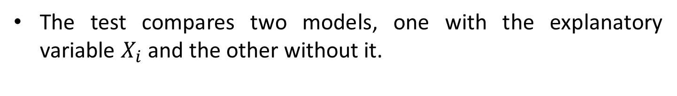

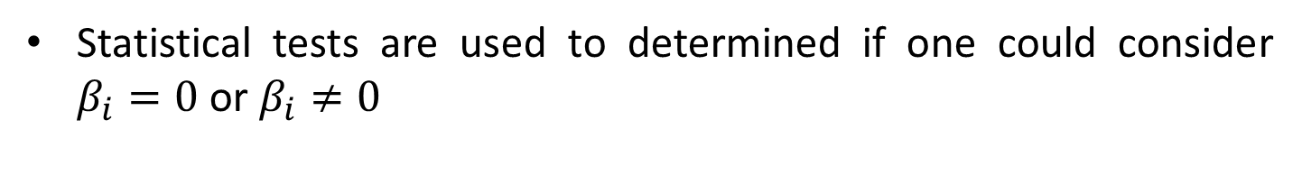
Statistical tests can be used to assess the importance or impact of one explanatory variable in the model
$$Y=β_{1}X_{1}+β_{2}X_{2}+⋯+β_{N}X_{N}+β_{0}+ε$$
Statistical tests are used to determined if one could consider $β_{i}=0$ or $β_{i}≠0$
$${H_{0}: β}_{i}=0 vs{{ H}_{1}: β}_{i}≠0$$
The test compares two models, one with the explanatory variable $X_{i}$ and the other without it.

Slide 13


The F-test is used to test the overall significance of the multivariate regression model
The F-test compares the multivariate regression model with a model with no explanatory variables
$${H_{0}: β}_{1}=β_{2}=β_{3}=⋯=β_{N}=0$$
$$vs$$
$${{ H}_{1}: β}_{i}≠0 for some i≥1$$
A decision can be made by analysing the statistical results

Slide 14
^{Analising} ^{the Statistical Results}
^{Oscar Rondon}
^{October 2018}

Slide 15
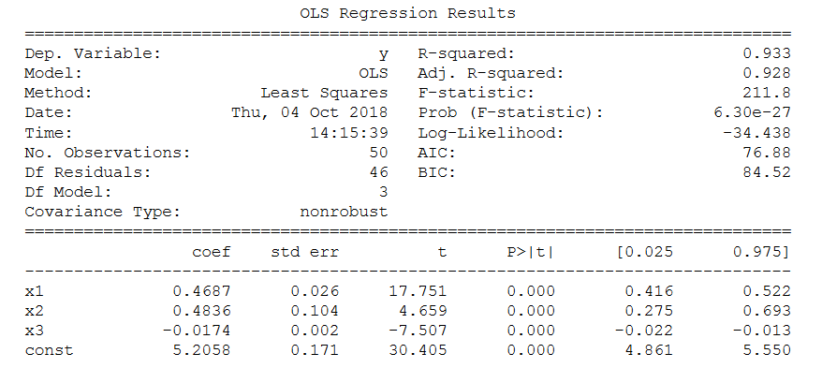
Most programs provide a set of statistical results to diagnose the multivariate regression model
Number of explanatory variables
$$Y=0.4687X_{1}+0.4836X_{2}−0.0174X_{3}+5.2058$$
coefficients

Slide 16
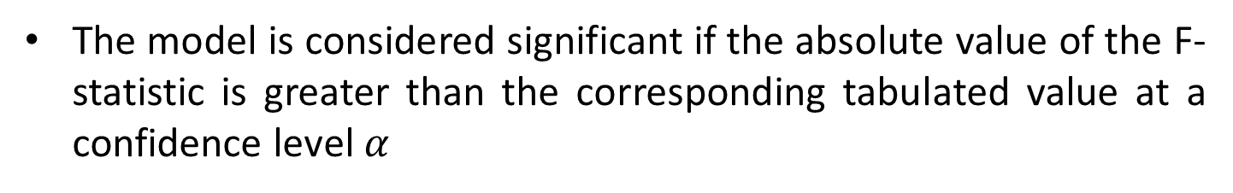
The model is considered significant if the absolute value of the F-statistic is greater than the corresponding tabulated value at a confidence level $α$
For this example, all explanatory variables seem to contribute to the response variable

Slide 17
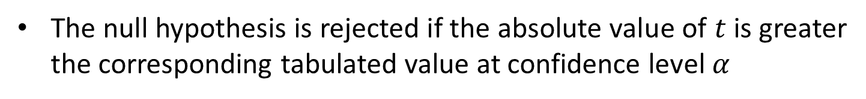
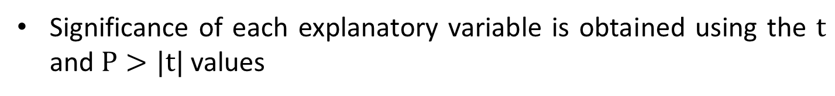
Significance of each explanatory variable is obtained using the $t$ and $P>|t|$values
The null hypothesis is rejected if the absolute value of $t$ is greater the corresponding tabulated value at confidence level $α$

Slide 18
AIC and BIC stand for Akaike’s and Bayesian information criteria respectively
The smaller the AIC and the BIC values the better the model
Useful when comparing two different models

